Slide 1

Panel on:
Networked Immersive Audio: opportunities and challenges
4th International Symposium on the Internet of Sounds
26-27 October 2023, Congress Center “Le benedettine”, Pisa, Italy
Angelo Farina

Slide 2
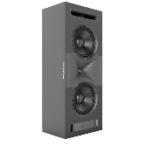

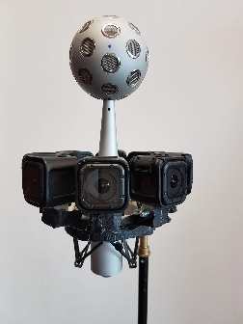
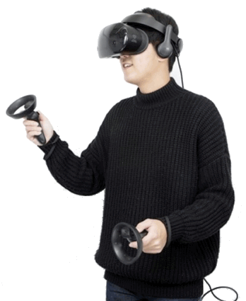

Spatial Audio capture and reproduction
Sound (and image) from one site must be transported with small latency to another site
Room 1
Room 2
OUTLINE
- Camera and microphone systems in Room 1
- Screen and loudspeakers, or HMD and headphones, in Room 2

Slide 3
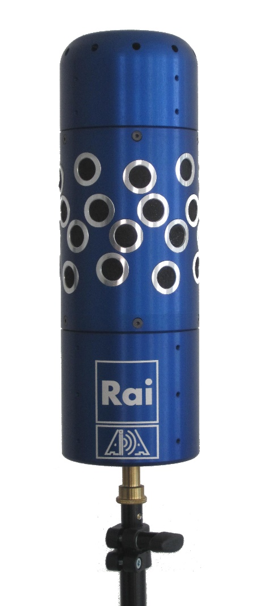
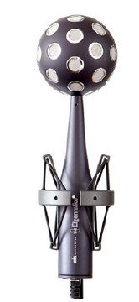
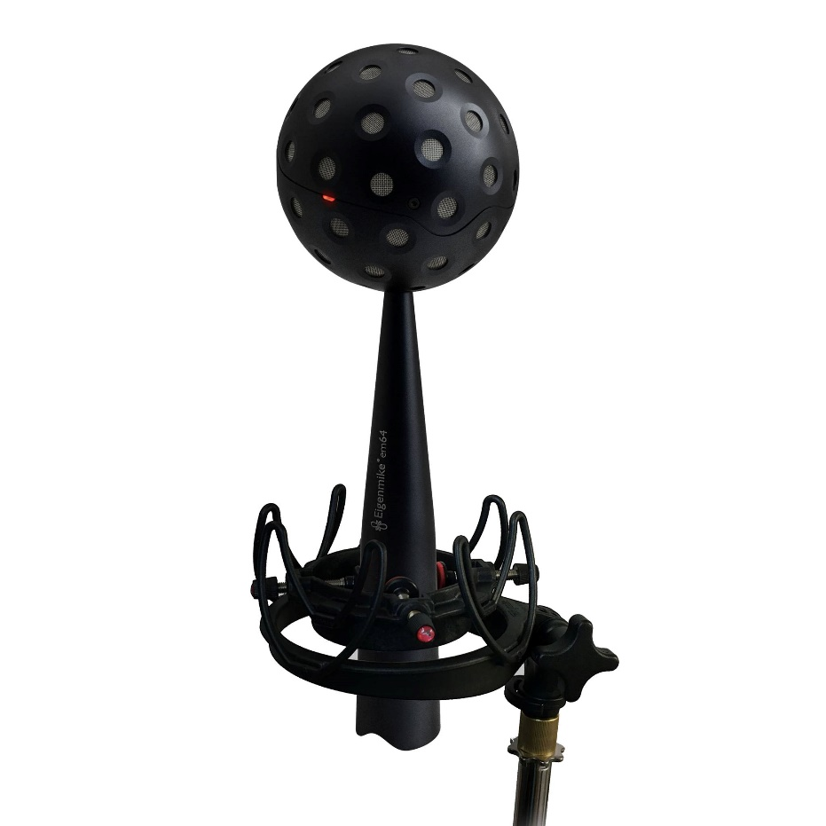
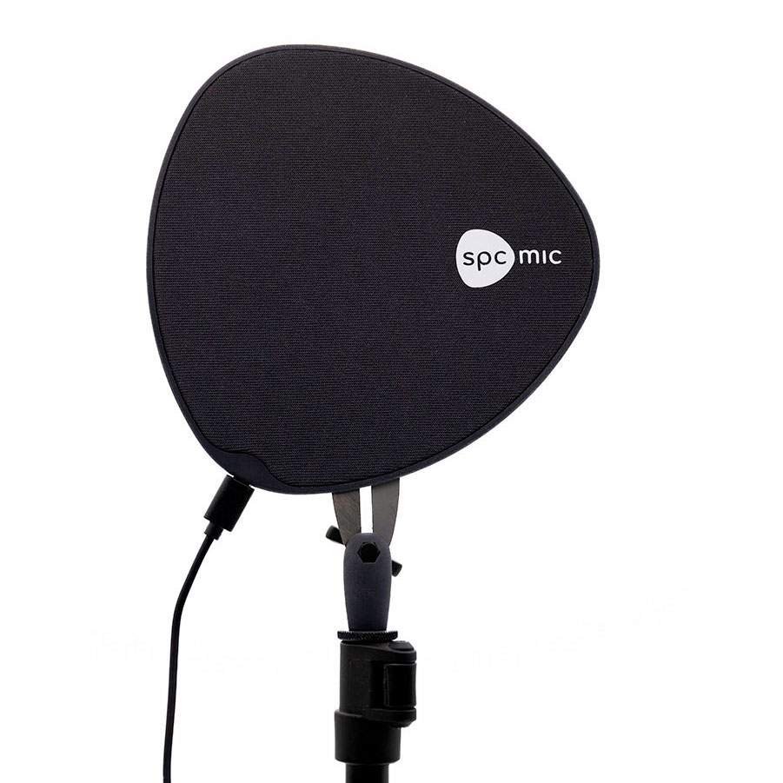
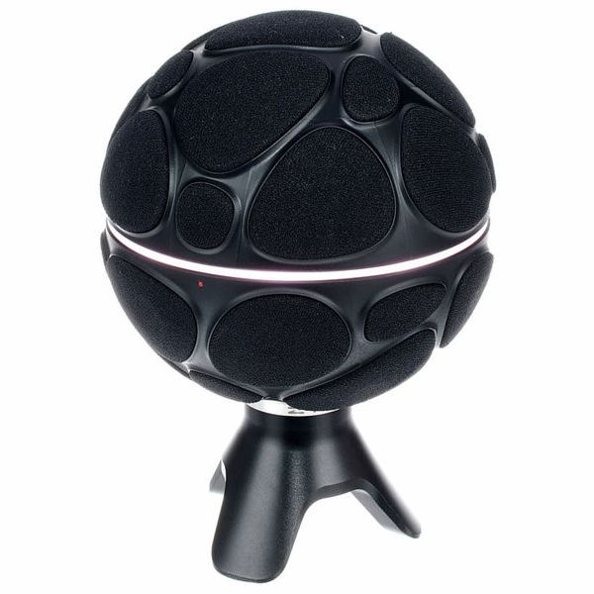
Microphone systems
In Parma we mostly employ compact and massive microphone arrays
Zylia
SPCMIC
Eigenmike 32
Eigenmike 64
AIDA

Slide 4
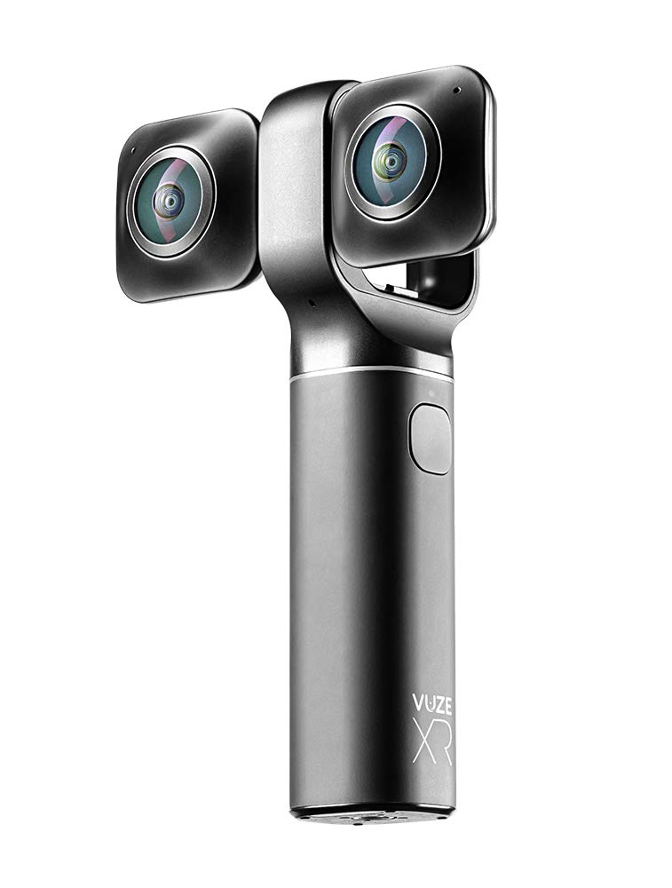
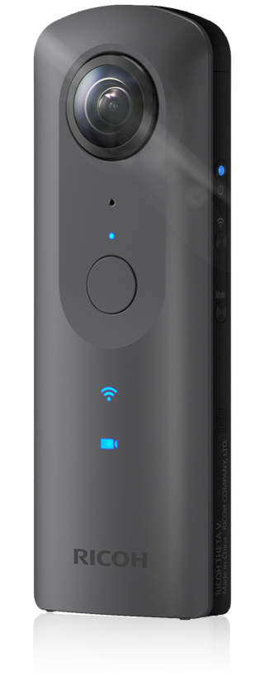
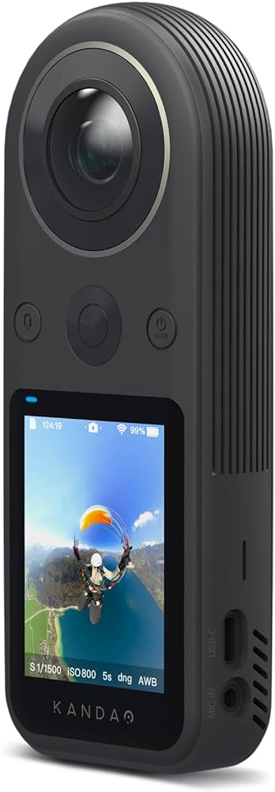
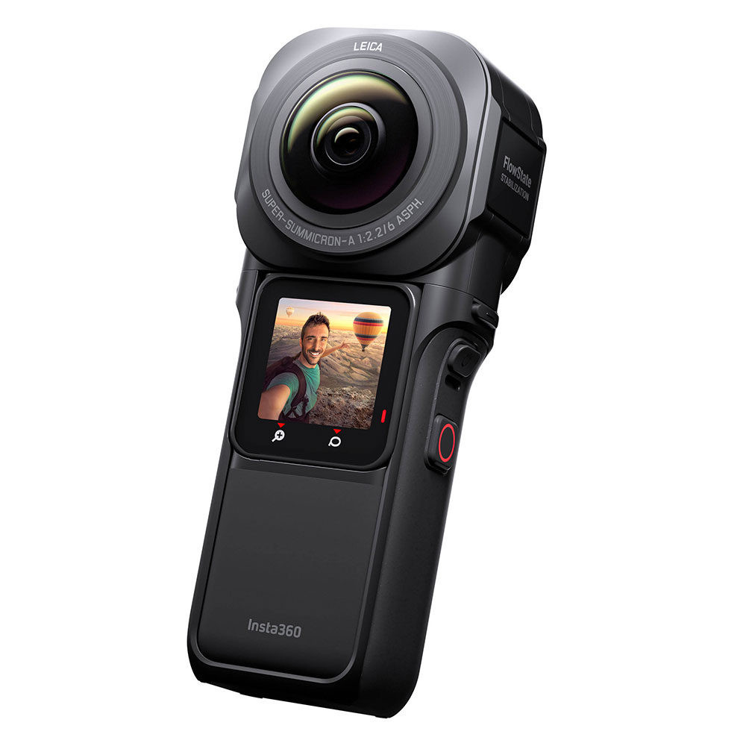
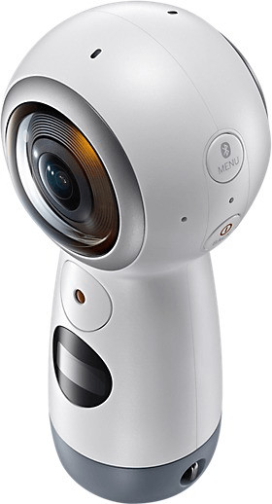
Camera systems
In Parma we mostly employ dual-lens compact cameras with streaming capability
VUZE XR
Samsung Gear 360
Ricoh Theta V
Qoocam 8k
Insta360 One RS1

Slide 5
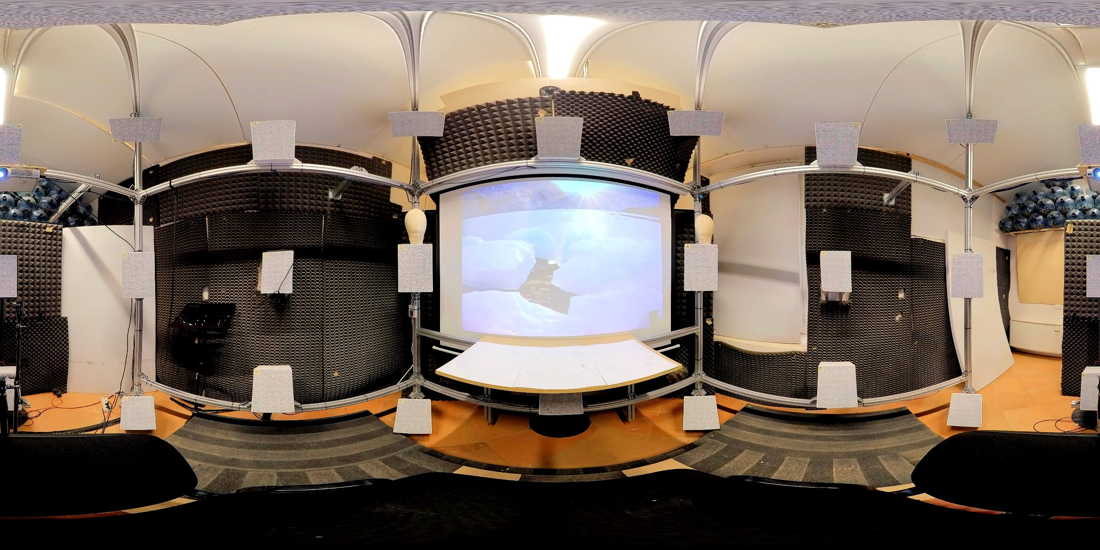
Multi-loudspeakers rooms
In Parma we have two immersive rooms – first one is High Order Ambisonics (25 ch) with one beamer

Slide 6
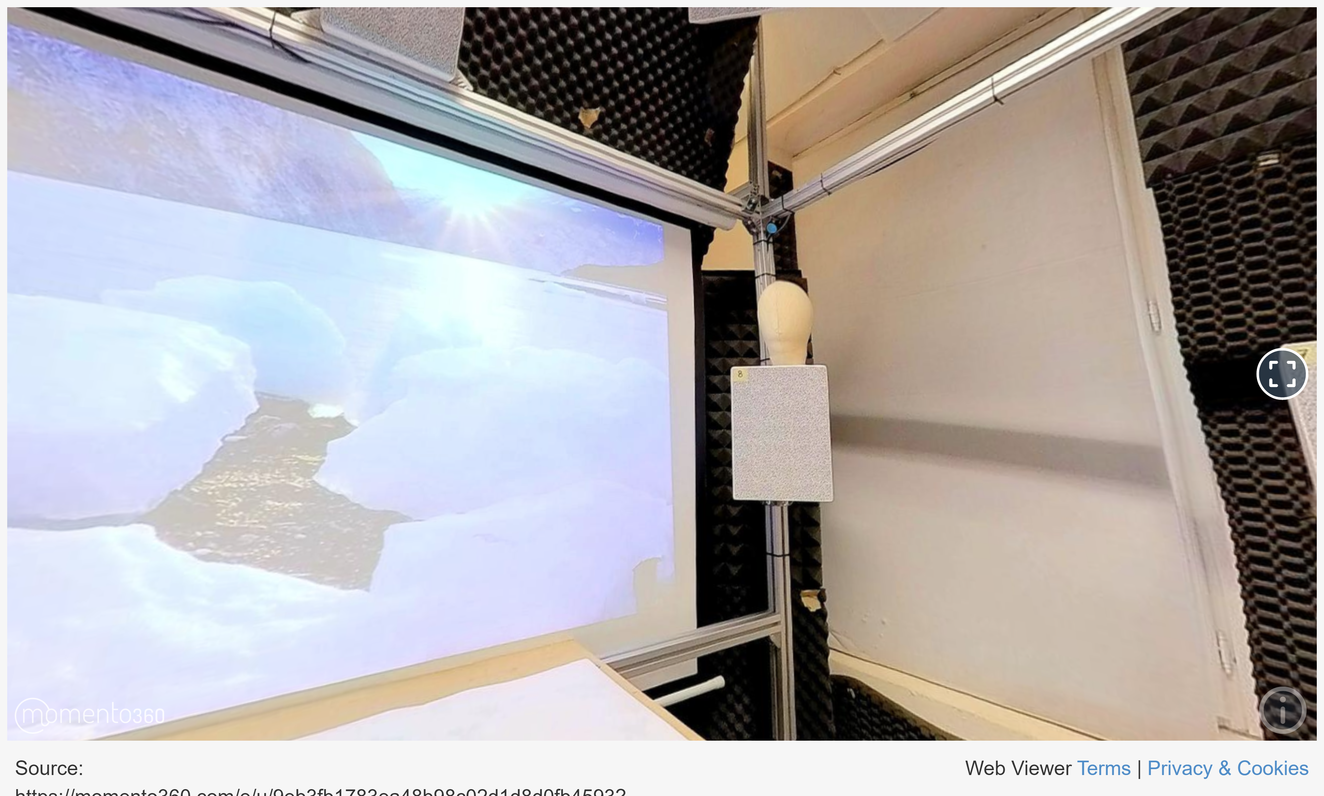
Multi-loudspeakers rooms
In Parma we have two immersive rooms – first one is High Order Ambisonics (25 ch) with one beamer

Slide 7
Multi-loudspeakers rooms
In Parma we have two immersive rooms – second one is WFS with 189 speakers and 4 beamers

Slide 8
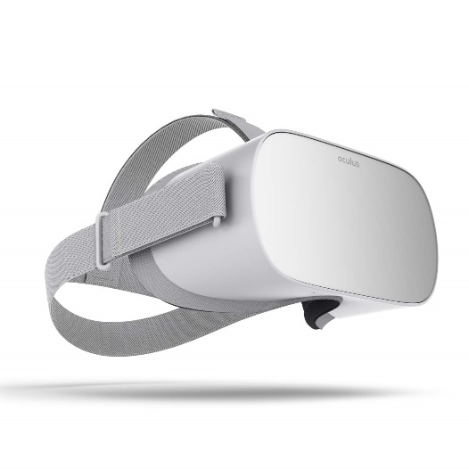
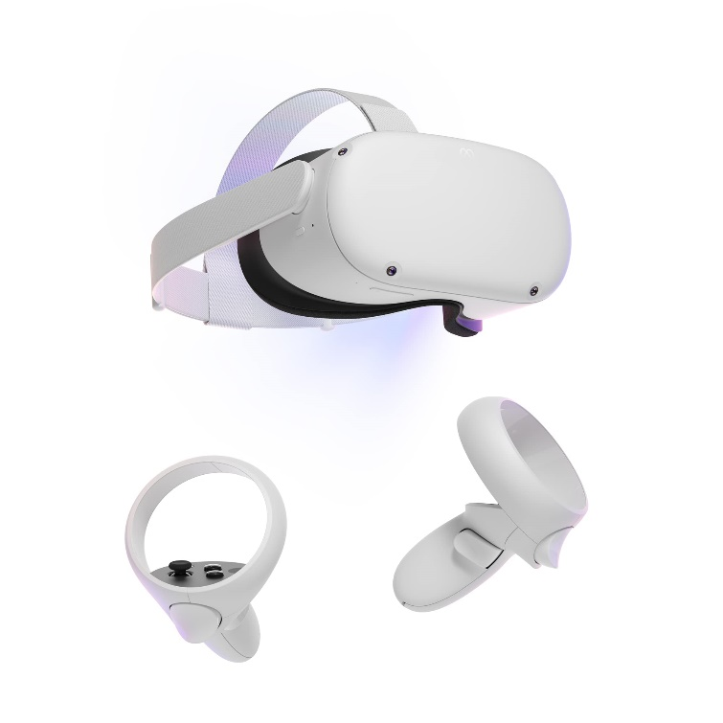
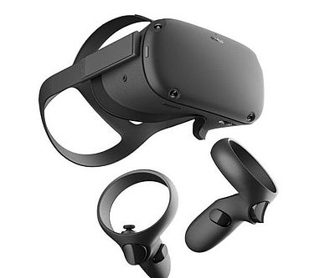
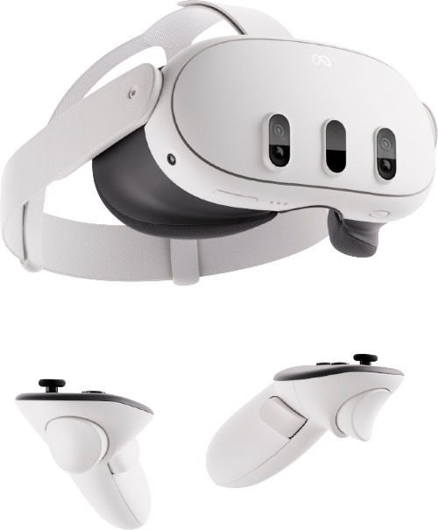
HMD with headphones
In Parma we have several HMD systems
Oculus GO
Oculus Quest
Oculus Quest 2
META Quest 3
HTC Vive
Samsung Odyssey+

Slide 9
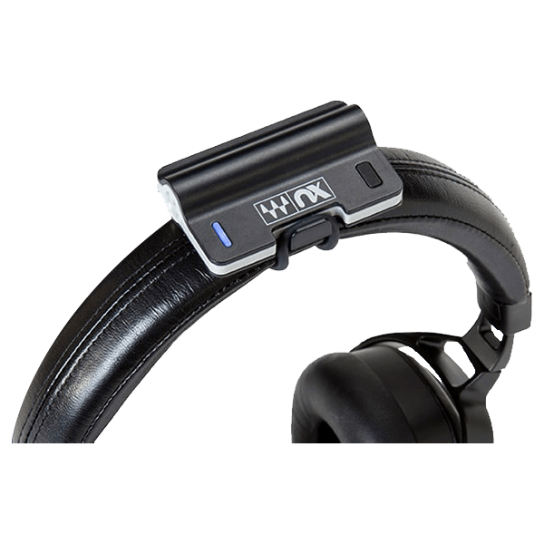
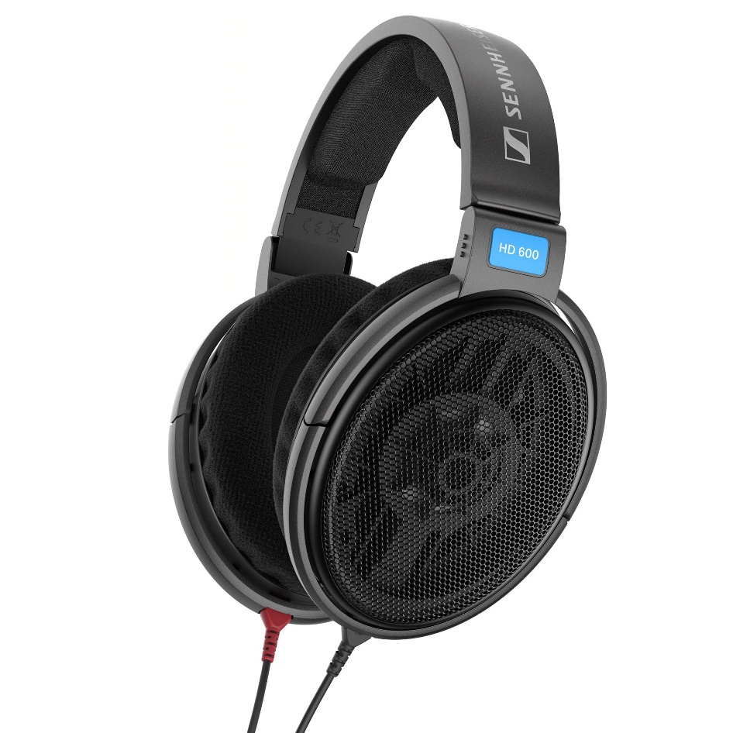
Headphones with headtrackers
In Parma we also use head trackers with headphones (no HMD)
- Sennheiser HD600 with Waves NX head tracker Audeze Mobius with embedded headtracking

Slide 10
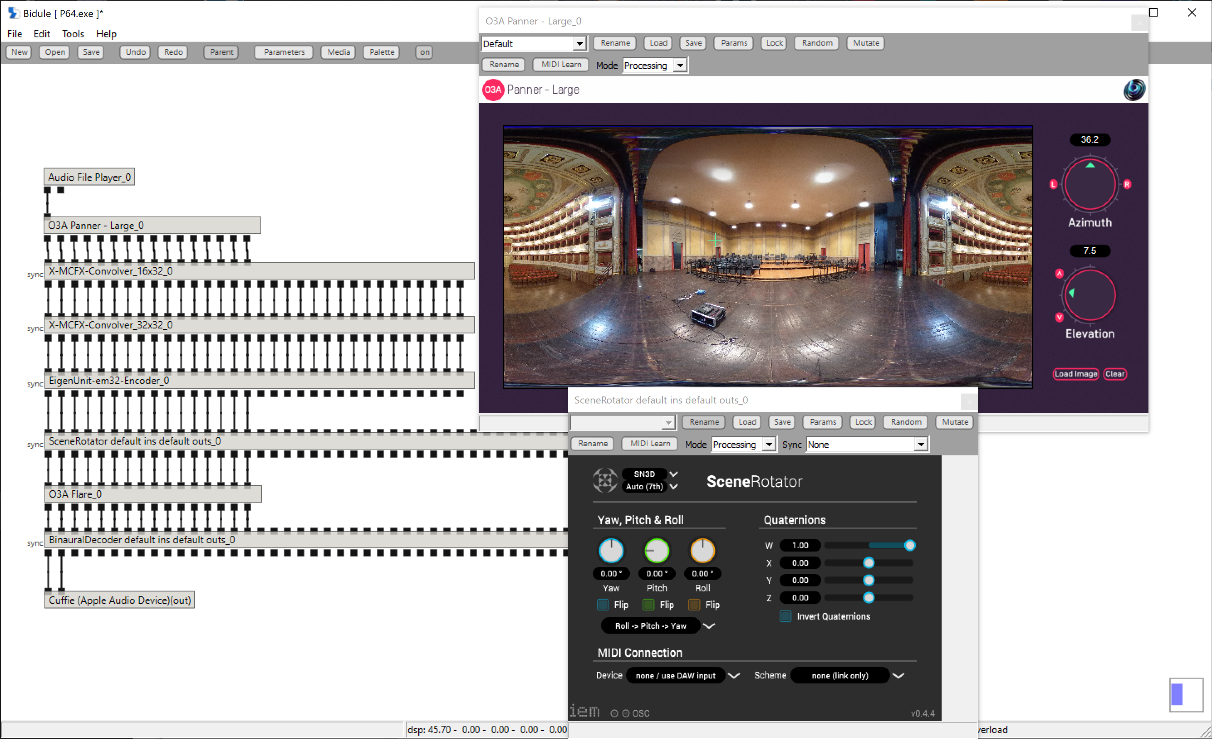
Software
We use Plogue Bidule as the host program (or Max), with VST plugins (Sparta, IEM, X-MCFX)

Slide 11
THANKS FOR ATTENTION
Questions ?

