Slide 1



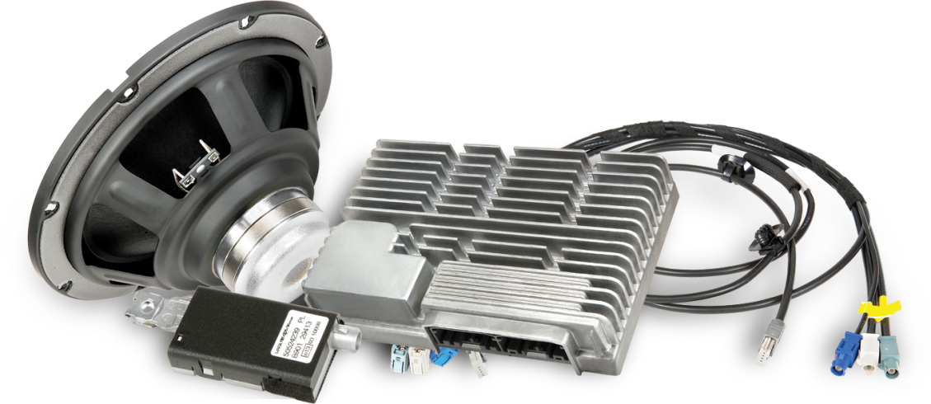
Integration of JVC/Kenwood's Exofield with auralization methods

Slide 2
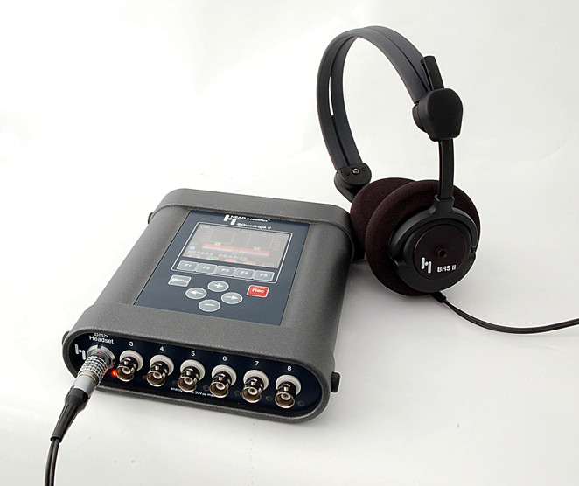
Contents
INTRODUCTION BACKGROUND PAST vs PRESENT VIRTUAL REALITY THE FUTURE: INSIDE VEHICLE
Tests performed at ASK on a car with the road noise cancellation system
Alternative to Head Acoustics

Slide 3
Contents
INTRODUCTION BACKGROUND PAST vs PRESENT VIRTUAL REALITY THE FUTURE: INSIDE VEHICLE
Background: a special test signal, the ESS - Exponential Sine Sweep
Background: the Kirkeby inversion method
- Binaural reproduction with stereo dipole (loudspeakers)
Current technology:
- Stereo reproduction with Exofield (headphones)
- Individualized HRTFs for Virtual Reality applications
New technology:
- Enhanced spatial reproduction inside vehicles

Slide 4
Measurement of a sound system
INTRODUCTION BACKGROUND PAST vs PRESENT VIRTUAL REALITY THE FUTURE: INSIDE VEHICLE
Noise n(t)
Nonlinear, time variant system
K[x(t)]
(loudspeakers)
Linear system
w(t) ⊗ h(t)
(propagation)
Input signal
x(t)
Distorted signal
w(t)
Output signal
y(t)
+
x(t): known test signal played through loudspeakers (or headphones)
Desired result: linear impulse response of the acoustic propagation h(t)
It is necessary to exclude the effect of the nonlinear part K and of the background noise n(t)
y(t): measured output signal

Slide 5
The test signal x(t): ESS
INTRODUCTION BACKGROUND PAST vs PRESENT VIRTUAL REALITY THE FUTURE: INSIDE VEHICLE
Input signal
x(t)
is a sine signal, which frequency is varied exponentially with time, starting at f₁ and ending at f₂ : EXPONENTIAL SINE SWEEP

Slide 6
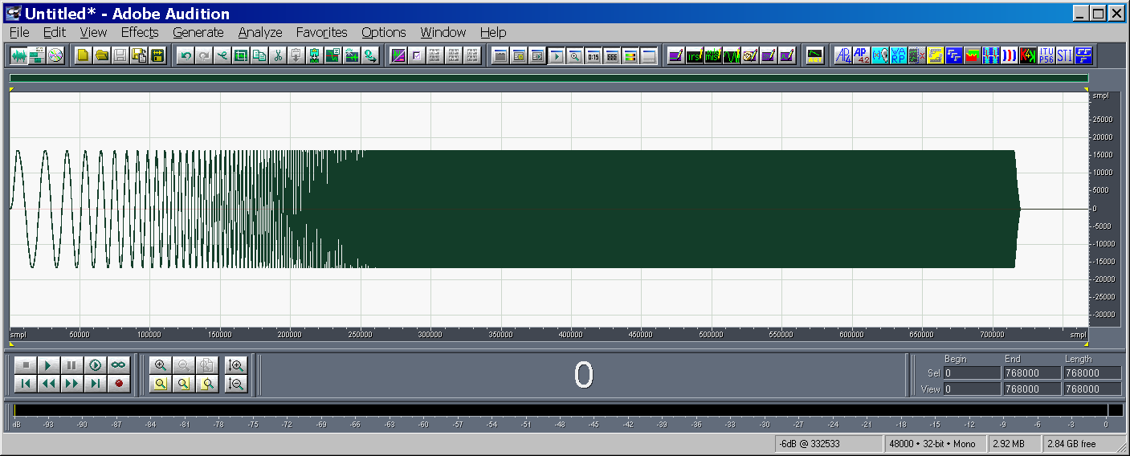
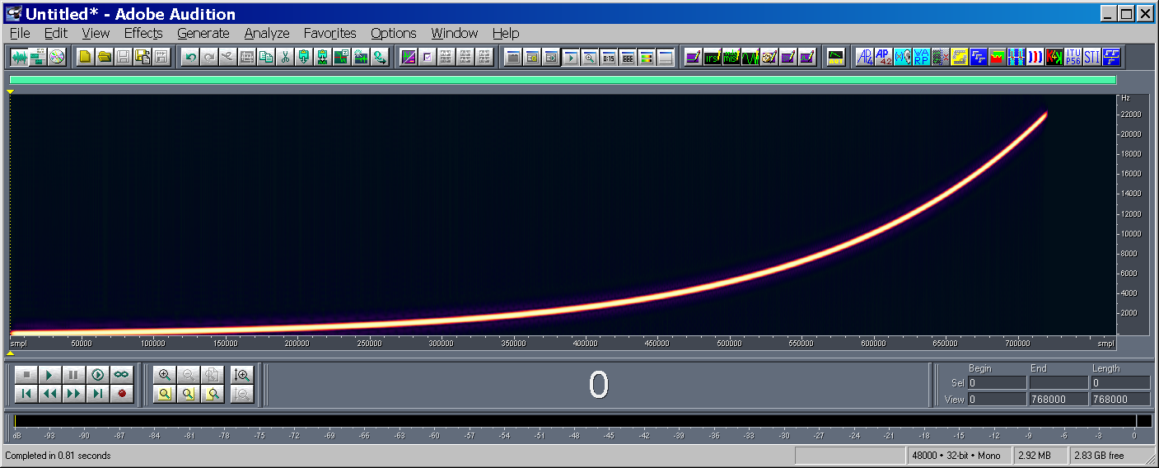
The test signal x(t): ESS
INTRODUCTION BACKGROUND PAST vs PRESENT VIRTUAL REALITY THE FUTURE: INSIDE VEHICLE

Slide 7
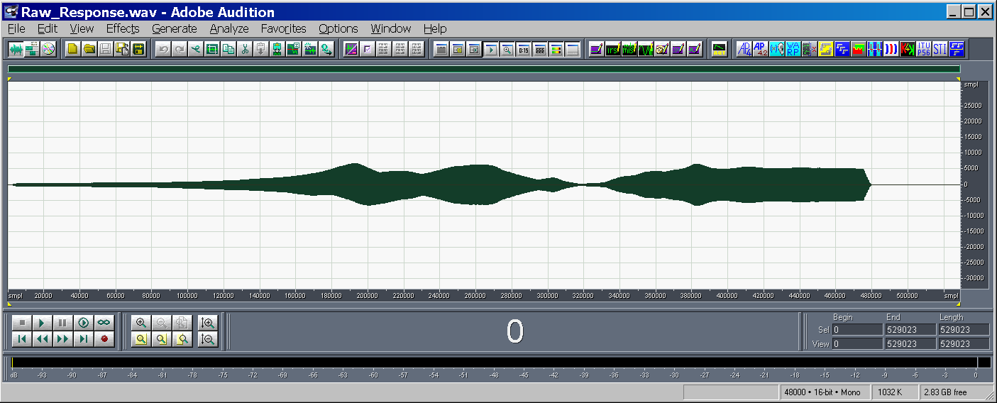
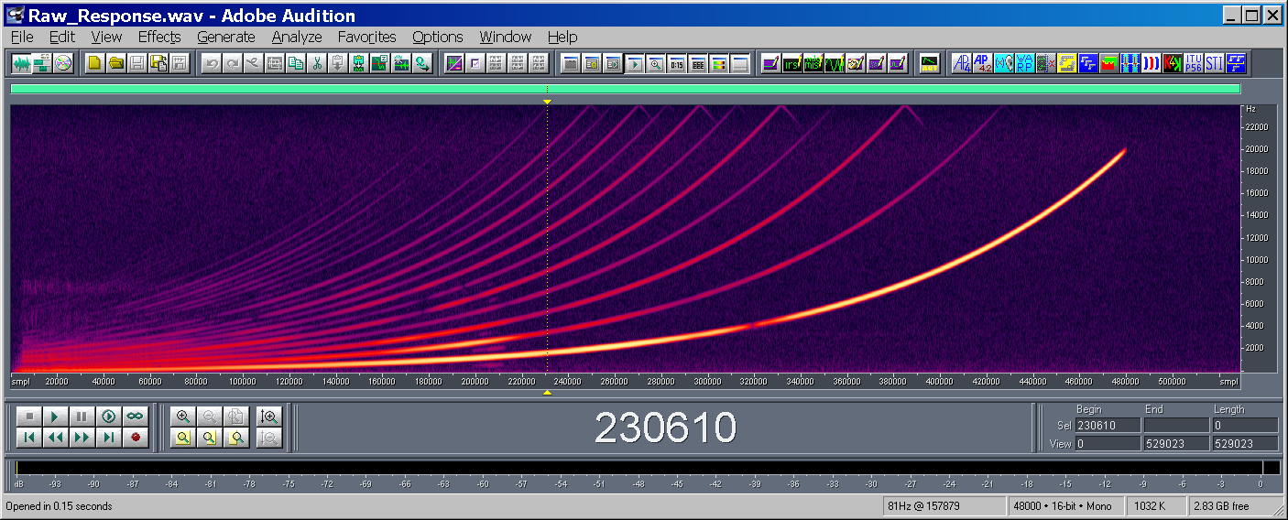
The system’s response y(t)
INTRODUCTION BACKGROUND PAST vs PRESENT VIRTUAL REALITY THE FUTURE: INSIDE VEHICLE
Nonlinear, time variant system
K[x(t)]
(loudspeakers)
The nonlinear behaviour of the loudspeaker causes many harmonics to appear

Slide 8
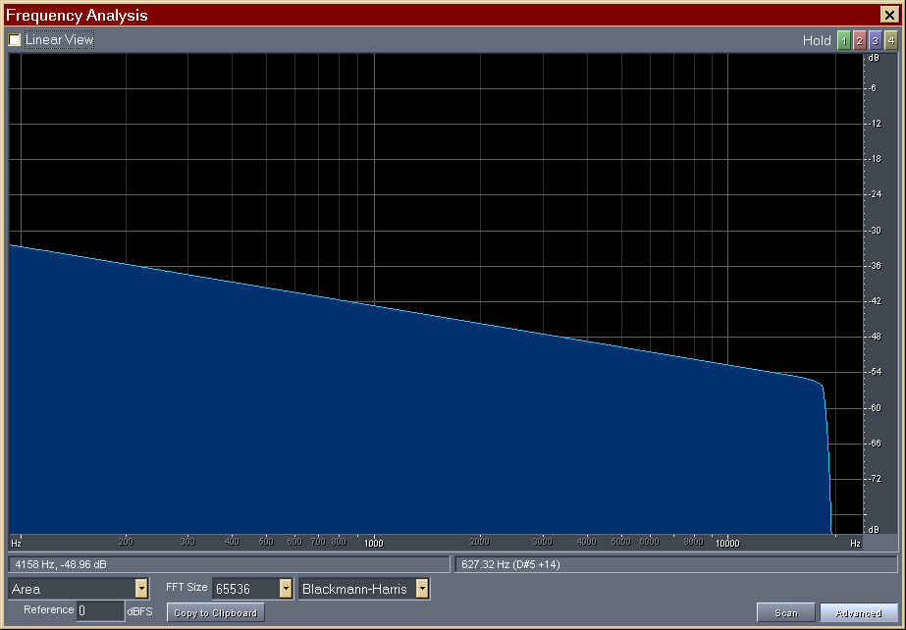
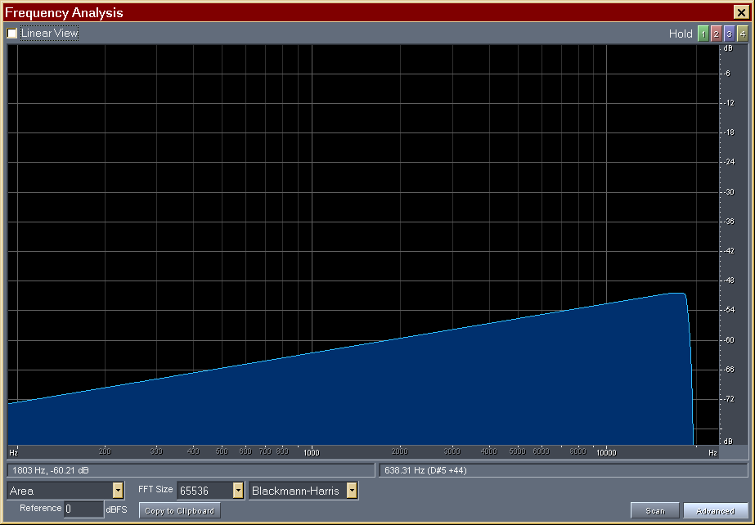
The inverse filter z(t)
INTRODUCTION BACKGROUND PAST vs PRESENT VIRTUAL REALITY THE FUTURE: INSIDE VEHICLE
Inverse filter z(t)
INVERSE SWEEP
The “time reversal mirror” technique: the inverse filter is the time-reversal of the test signal. As the log sine sweep has a spectrum falling down of 3 dB/Octave, proper equalization is required.
Test Signal x(t)
Inverse Filter z(t)

Slide 9
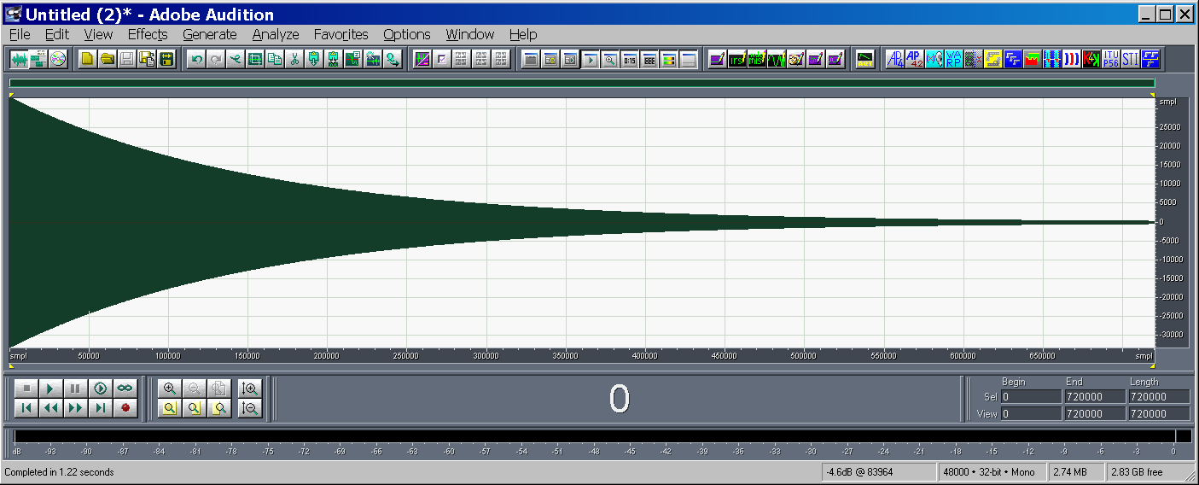
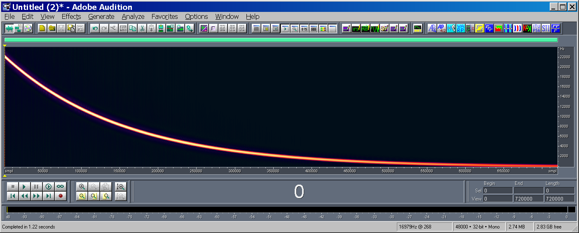
The inverse filter z(t)
INTRODUCTION BACKGROUND PAST vs PRESENT VIRTUAL REALITY THE FUTURE: INSIDE VEHICLE
Inverse filter z(t)
INVERSE SWEEP

Slide 10
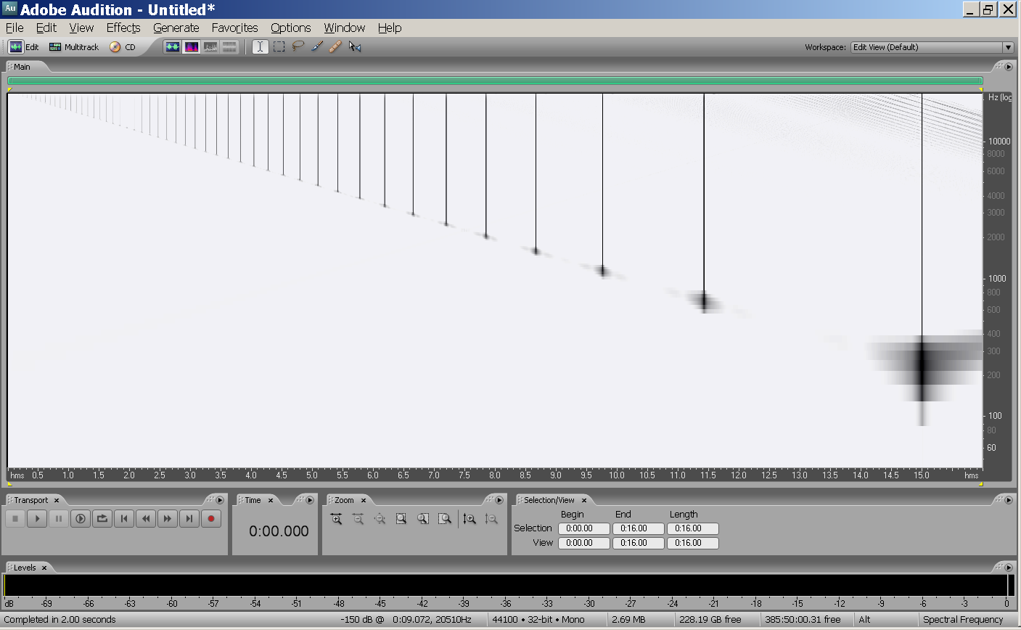
y(t)*z(t)
INTRODUCTION BACKGROUND PAST vs PRESENT VIRTUAL REALITY THE FUTURE: INSIDE VEHICLE
The measured signal y(t) is convolved with the inverse filter z(t). This operation causes a counter-clockwise rotation of time-frequency plane
y(t) ⊗ z(t)
(deconvolution)

Slide 11
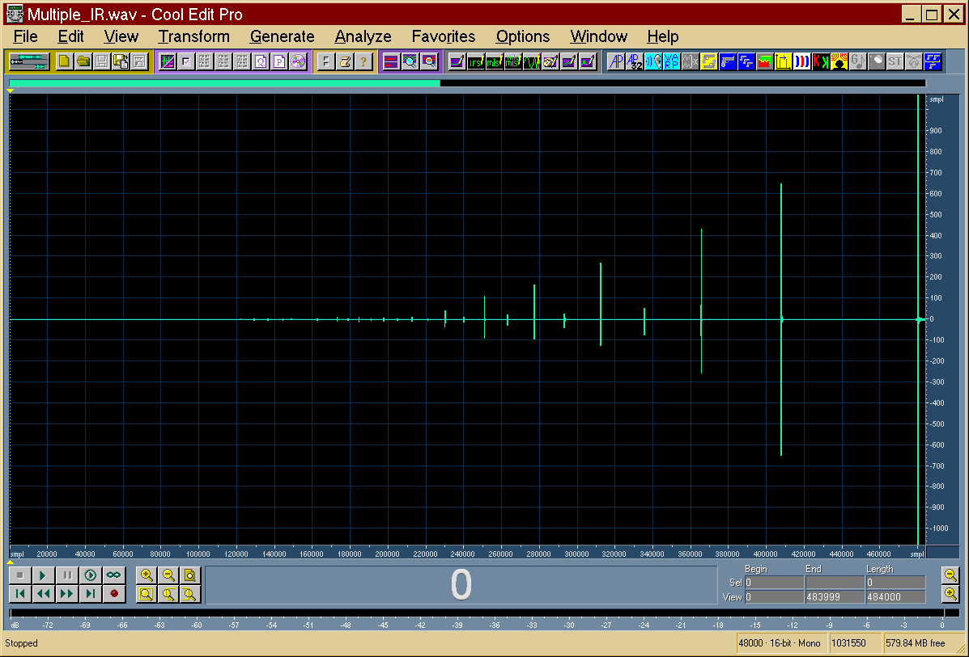
y(t)*z(t)
INTRODUCTION BACKGROUND PAST vs PRESENT VIRTUAL REALITY THE FUTURE: INSIDE VEHICLE
y(t) ⊗ z(t)
(deconvolution)
2°
3°
5°
The previous are the harmonics distortion products of various orders
The last impulse response is the linear one
1°

Slide 12
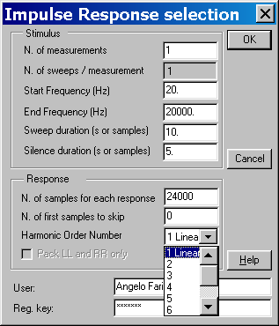
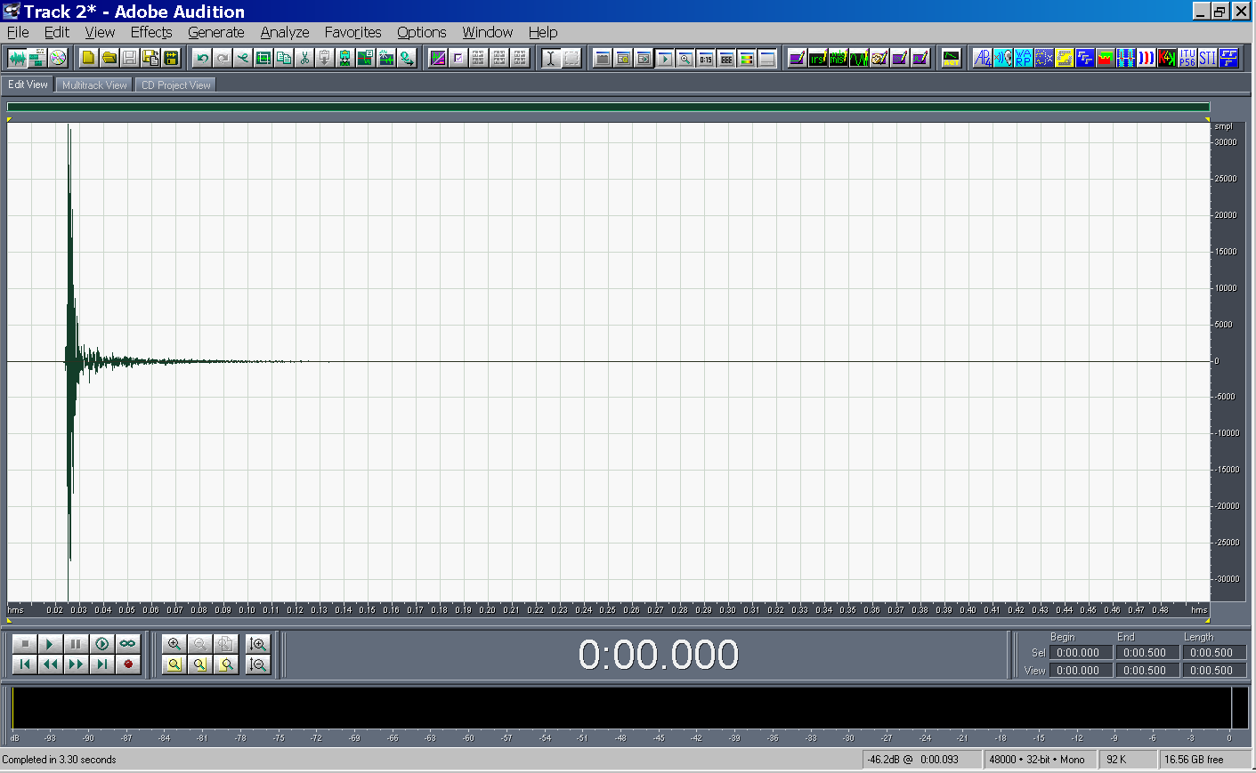
The linear impulse response h(t)
INTRODUCTION BACKGROUND PAST vs PRESENT VIRTUAL REALITY THE FUTURE: INSIDE VEHICLE
After the sequence of impulse responses has been obtained, it is possible to automatically trim just the linear one:

Slide 13
Benefits of the ESS signal
INTRODUCTION BACKGROUND PAST vs PRESENT VIRTUAL REALITY THE FUTURE: INSIDE VEHICLE
Energy is spread over time: safer for loudspeakers
The deconvolution packs all the energy in a very short impulse response: S/N ratio gets a boost up to 70 dB or more !
Nonlinear effects are avoided
Measurement is very fast: for most applications a 10s sweep is long enough

Slide 14
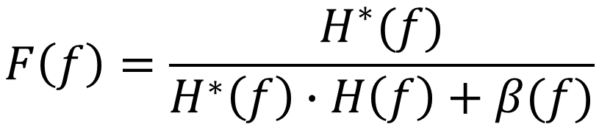
The Kirkeby inversion
INTRODUCTION BACKGROUND PAST vs PRESENT VIRTUAL REALITY THE FUTURE: INSIDE VEHICLE
In many cases the IR h(t) must be inverted, finding an inverse filter f(t) so that h(t)*f(t)=δ(t)
This operation is performed with the Kirkeby method in frequency domain [h(t) becomes H(f)]
A frequency-dependent regularization parameter β(f) is used
$$F\left(f\right)=\frac{H^{∗}(f)}{H^{∗}\left(f\right)∙H\left(f\right)+β(f)}$$

Slide 15
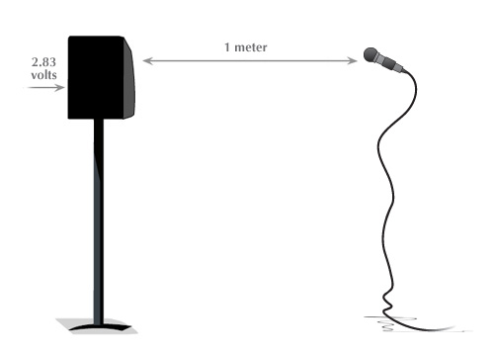
An example of using the Kirkeby inversion
INTRODUCTION BACKGROUND PAST vs PRESENT VIRTUAL REALITY THE FUTURE: INSIDE VEHICLE
The IR inversion can be used for correcting the response of a loudspeaker
A high quality omnidirectional mic is used to record the IR
The IR is inverted to obtain a pre-equalization filter
The music signal is realtime convolved with this pre-eq filter
This prefiltered signal corrects the loudspeaker and flattens the spectrum

Slide 16
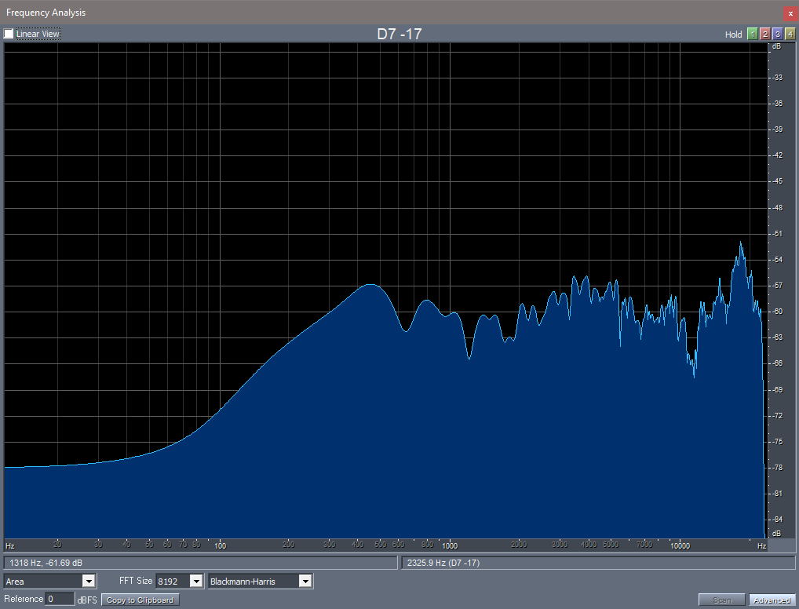
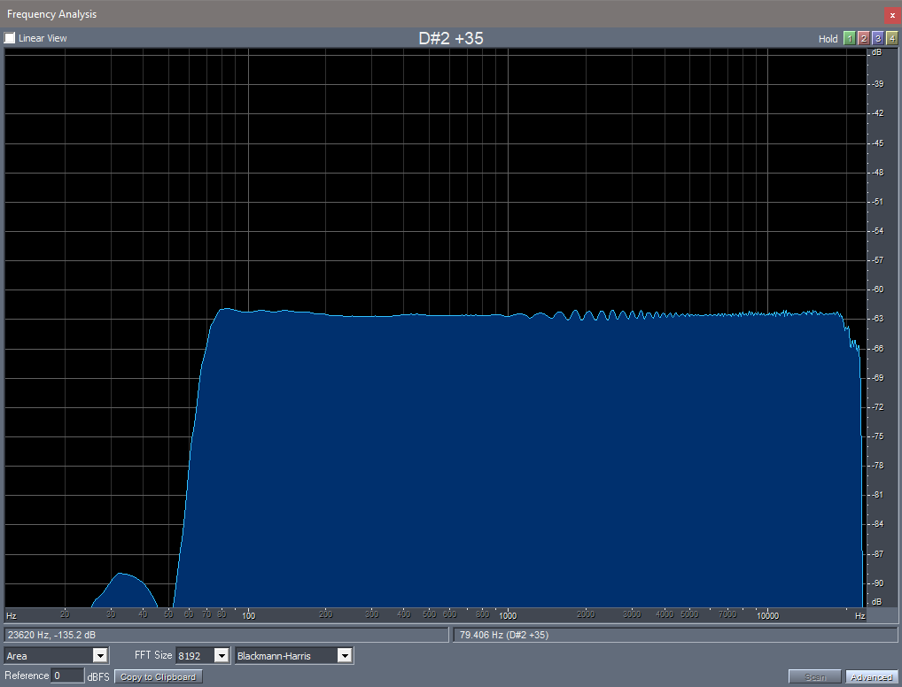
An example of using the Kirkeby inversion
INTRODUCTION BACKGROUND PAST vs PRESENT VIRTUAL REALITY THE FUTURE: INSIDE VEHICLE
Before correction
After equalization

Slide 17
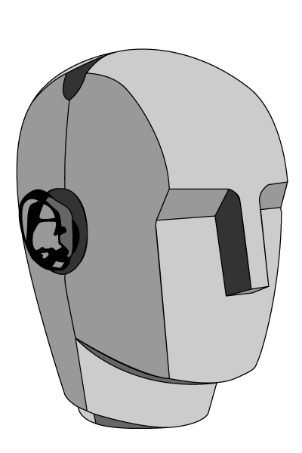
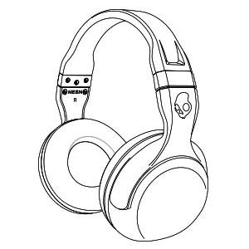
The Stereo Dipole
INTRODUCTION BACKGROUND PAST vs PRESENT VIRTUAL REALITY THE FUTURE: INSIDE VEHICLE
Binaural recording and headphones playback
Binaural recording and loudspeakers playback

Slide 18
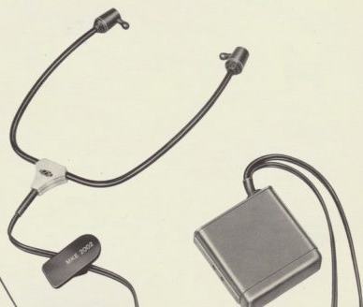
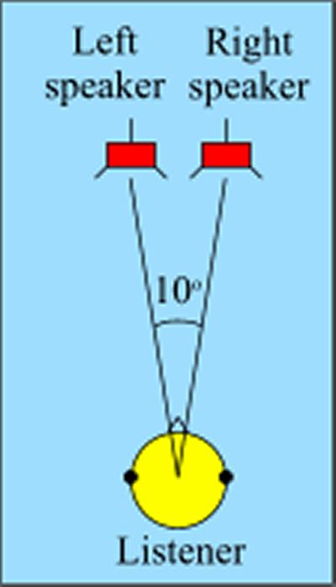
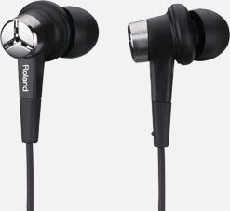
The Stereo Dipole
INTRODUCTION BACKGROUND PAST vs PRESENT VIRTUAL REALITY THE FUTURE: INSIDE VEHICLE
Binaural out-ear microphones
10° angle between two Studio Monitors

Slide 19
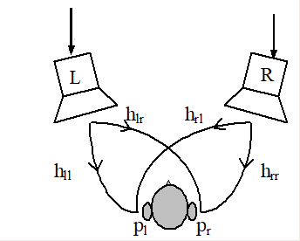
The Stereo Dipole
INTRODUCTION BACKGROUND PAST vs PRESENT VIRTUAL REALITY THE FUTURE: INSIDE VEHICLE
Sine sweep
1. ESS test signal is played through each loudspeaker
2. The response is recorded by each binaural microphone
3. Four impulse responses are measured)
Ipse-lateral transfer function
Cross-talk transfer function

Slide 20
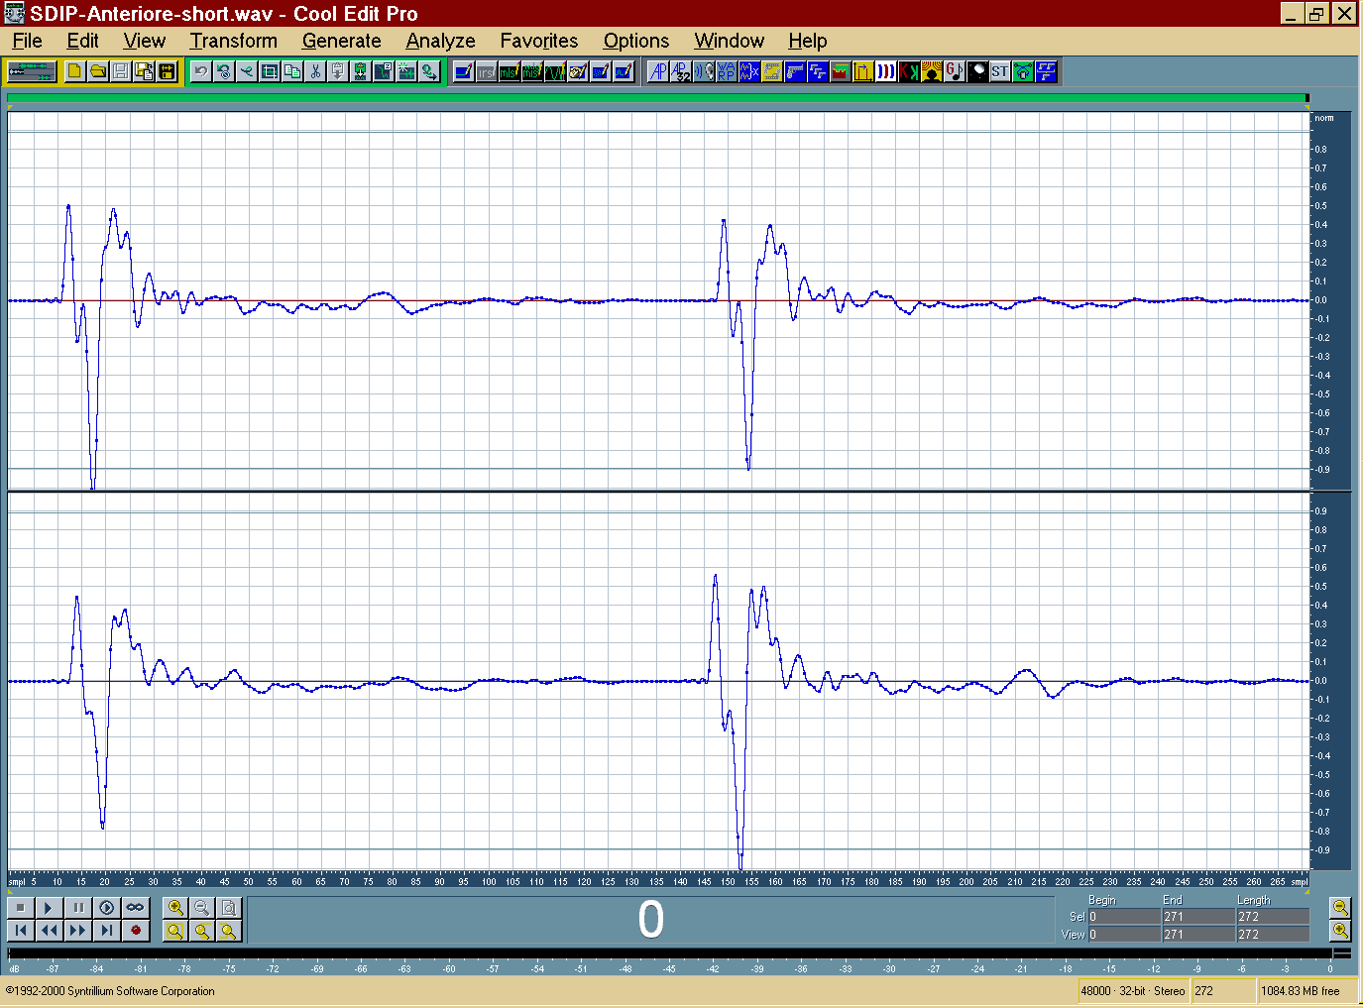
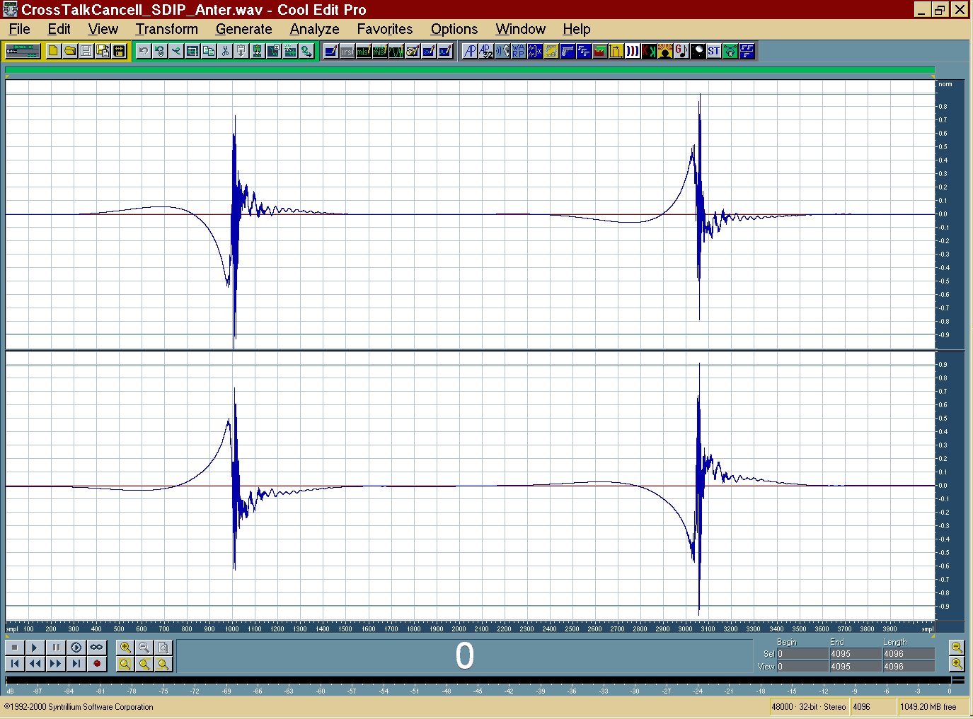
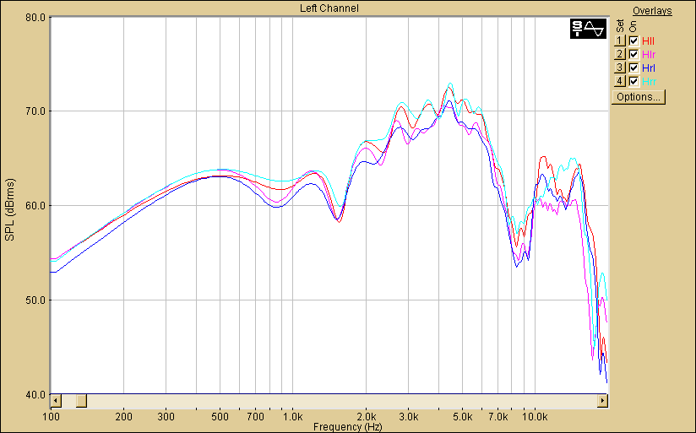
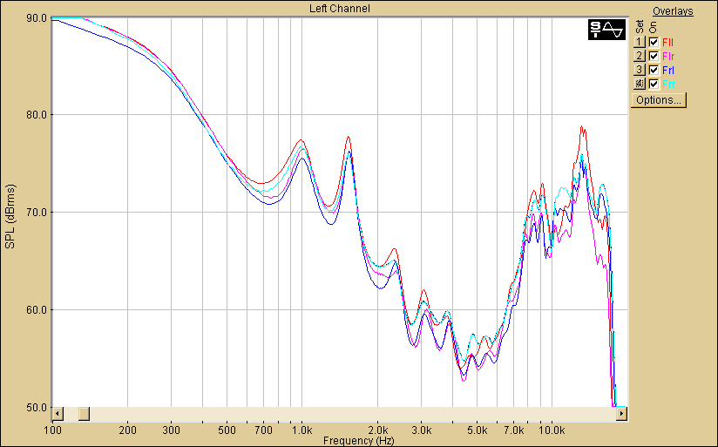
The Stereo Dipole
INTRODUCTION BACKGROUND PAST vs PRESENT VIRTUAL REALITY THE FUTURE: INSIDE VEHICLE
3. Four impulse responses are obtained
4. IRs are inverted to get 4 filters
Kirkeby

Slide 21
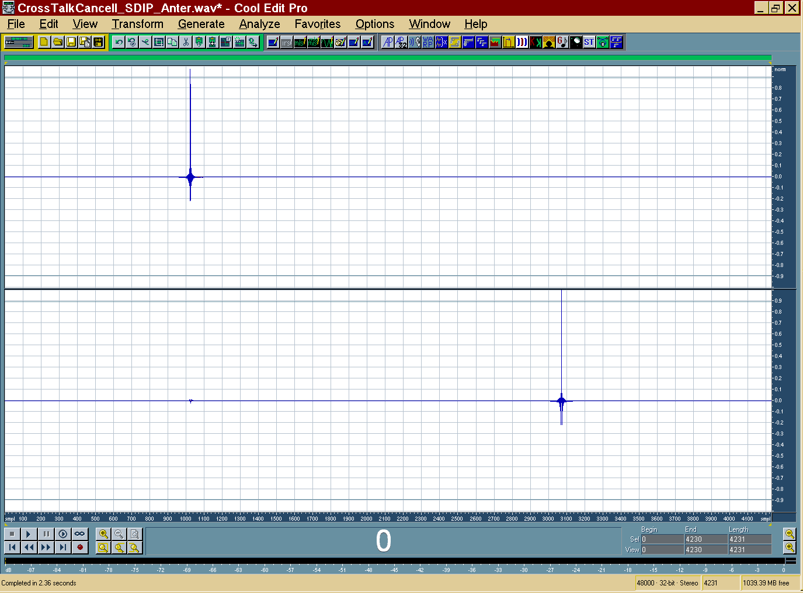
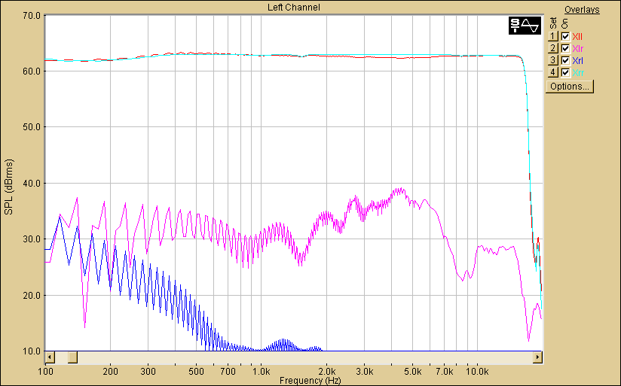
The Stereo Dipole
INTRODUCTION BACKGROUND PAST vs PRESENT VIRTUAL REALITY THE FUTURE: INSIDE VEHICLE
5. Filters and IRs are convolved to get a “Cross-talk cancelling effect”
At least 25dB of attenuation between direct and cross-talk contribution
Regularization parameter

Slide 22
The Stereo Dipole
INTRODUCTION BACKGROUND PAST vs PRESENT VIRTUAL REALITY THE FUTURE: INSIDE VEHICLE
6. Preconvolving the signal with the Crosstalk cancelling filter, the sound played by a loudspeaker is listened only by the corresponding ear: cross-talk contribution are cancelled by each other

Slide 23
The Standard Exofield method
INTRODUCTION BACKGROUND PAST vs PRESENT VIRTUAL REALITY THE FUTURE: INSIDE VEHICLE
h are measured in a standard stereo setup
to Headphones through eq filters

Slide 24
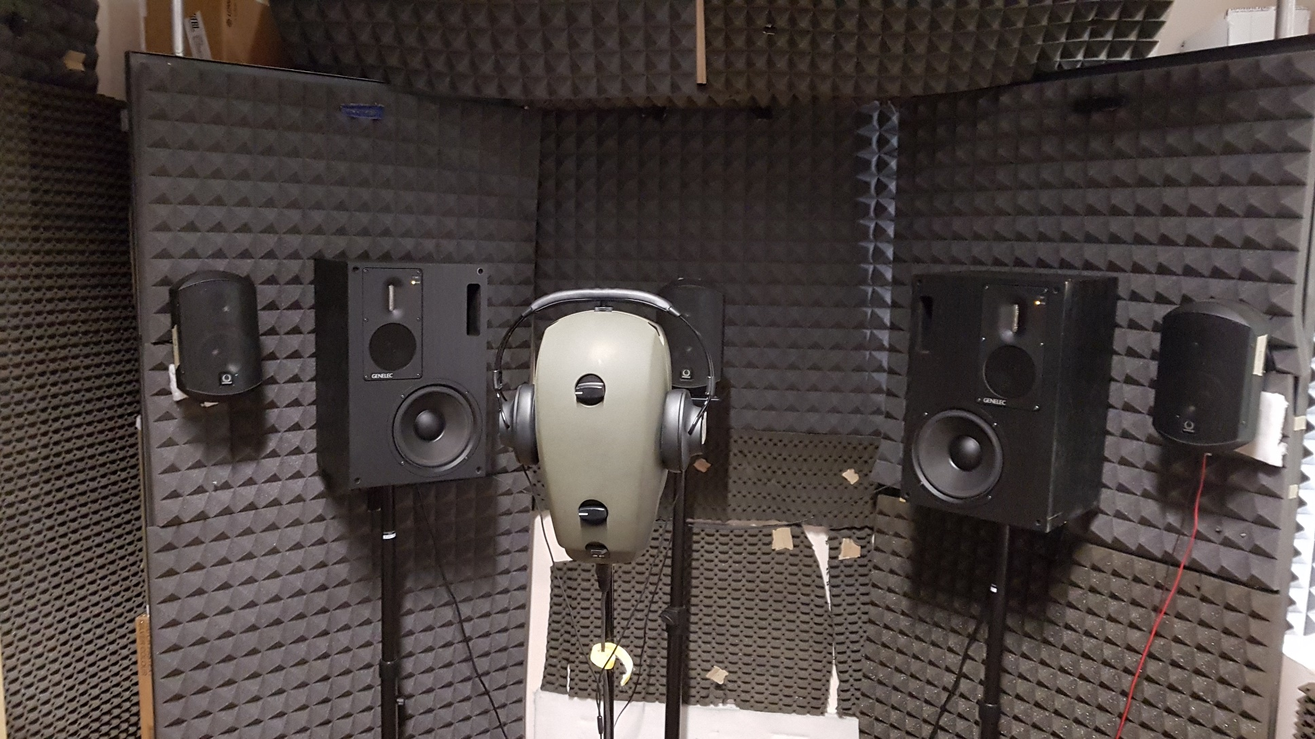
The Standard Exofield method (UNIPR version)
INTRODUCTION BACKGROUND PAST vs PRESENT VIRTUAL REALITY THE FUTURE: INSIDE VEHICLE
Stereo configuration (60° angle)

Slide 25
The Standard Exofield method (UNIPR version)
INTRODUCTION BACKGROUND PAST vs PRESENT VIRTUAL REALITY THE FUTURE: INSIDE VEHICLE
Exofield with the ESS and Kirkeby:
Emulation of a stereo setup of two top-level studio monitors (Genelec) in a standard stereo setup
Measurement is very fast and robust to background noise
Non linearities of loudspeakers are avoided
Accurate equalization with inverse filters capable of correcting both magnitude and phase of the headphones

Slide 26
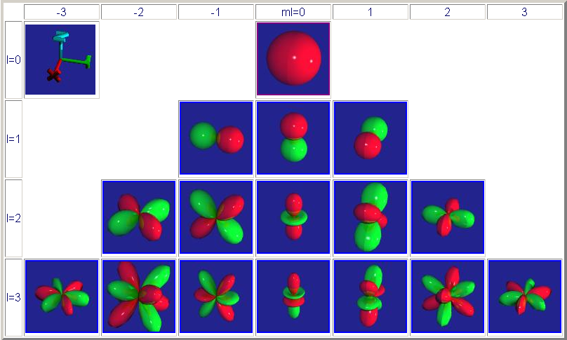
Fundamentals of Ambisonics
INTRODUCTION BACKGROUND PAST vs PRESENT VIRTUAL REALITY THE FUTURE: INSIDE VEHICLE
The soundfield is decomposed in spherical harmonics of various order
Order_0
(omni mic)
Order_1
Three velocity components
Order_2
Order_3

Slide 27
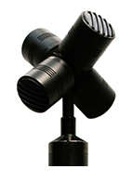
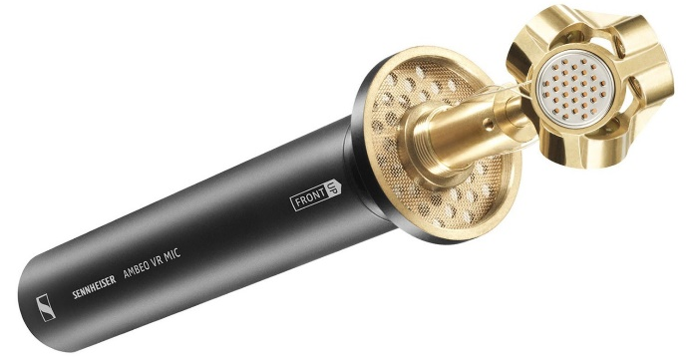
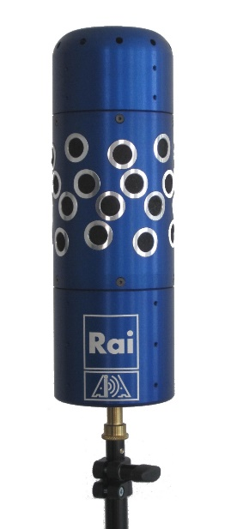
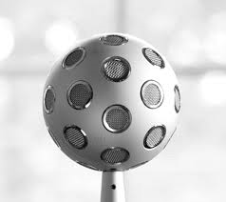
Ambisonics microphone arrays
INTRODUCTION BACKGROUND PAST vs PRESENT VIRTUAL REALITY THE FUTURE: INSIDE VEHICLE
Microphone arrays are used for capturing spatial information
Soundfield
Ambeo
FOA – first order Ambisonics:
HOA – High order Ambisonics:
RAI/AIDA
3DVMS
Eigenmike

Slide 28


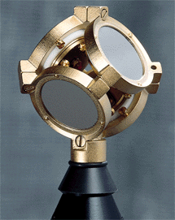


First order Ambisonics (4 channels)
INTRODUCTION BACKGROUND PAST vs PRESENT VIRTUAL REALITY THE FUTURE: INSIDE VEHICLE
FOA microphones: allow for simultaneous measurements of the sound pressure (omni) and of the three Cartesian components of particle velocity (figure-of-8 patterns)
Pressure
Vx
Vz
Vy

Slide 29
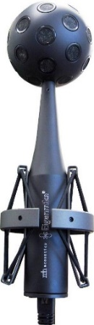
High Order Ambisonics
INTRODUCTION BACKGROUND PAST vs PRESENT VIRTUAL REALITY THE FUTURE: INSIDE VEHICLE
HOA microphones: the Eigenmike allows for simultaneous recording of 32 signals, from which it is possible to derive spherical harmonics signals up to 4th order

Slide 30
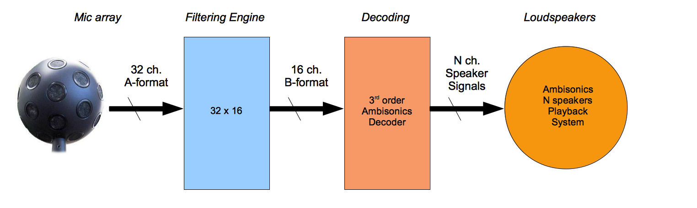
Ambisonics encoding and decoding
INTRODUCTION BACKGROUND PAST vs PRESENT VIRTUAL REALITY THE FUTURE: INSIDE VEHICLE
Encoding into spherical harmonics
Decoding to reproduction system
Mic array
Loudspeakers
N x M
Encoding matrix
M x K
Decoding matrix
A-format
B-format
Headphones
Mic array: 4ch with FOA mics, 32ch with Eigenmike
B-format: 4ch for FOA, 16ch for 3rd order Ambisonics

Slide 31
Ambisonics encoding
INTRODUCTION BACKGROUND PAST vs PRESENT VIRTUAL REALITY THE FUTURE: INSIDE VEHICLE
N x M
Encoding matrix
A FIR filtering matrix, directly derived from anechoic measurements
Array placed on a 2-axis turning table
δ(t)
d = 1…D
directions
The A to B-format filter matrix is calculated inverting a set of IRs measured in anechoic room from 362 directions (SIR – Spatial Impulse Response), by means of Kirkeby.
n = 1…N
microphones
Depending on the purpose, a desired number M of VIRTUAL MICROPHONES can be obtained.
δ(t)
This processing technique is called 3DVMS and was developed by the RAI Research Center in Turin and AIDA, a spinoff of the University of Parma.

Slide 32

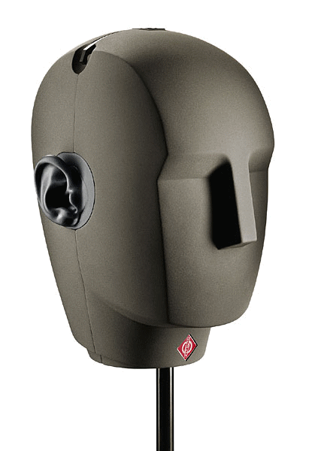
Ambisonics Decoding for loudspeakers
INTRODUCTION BACKGROUND PAST vs PRESENT VIRTUAL REALITY THE FUTURE: INSIDE VEHICLE
M x K
Decoding matrix
Also the decoding can be performed by means of a FIR filtering matrix
Loudspeakers system: an Ambisonics decoder is used with the desired number of output channels K (8 in this example) and optimized for the specific configuration (i.e.: Rapture3D from Blue Ripple Sound).

Slide 33
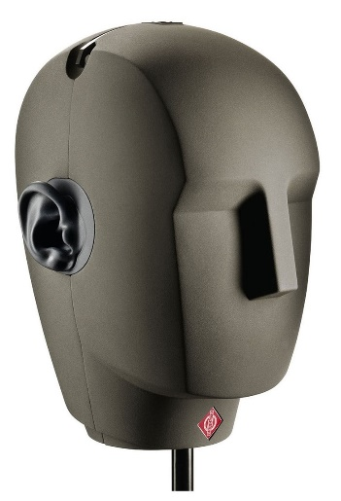
Ambisonics Decoding over headphones
INTRODUCTION BACKGROUND PAST vs PRESENT VIRTUAL REALITY THE FUTURE: INSIDE VEHICLE
M x K
Decoding matrix
K x 2
HRTF matrix
The K speaker signals are convolved with the corresponding HRTFs
*
The past: generic HRTFs from dummy head (Neumann KU100)
Headphones:
Now: personal HRTFs thanks to EXOFIELD MICROPHONES

Slide 34
Ambisonics over headphones with Exofield
INTRODUCTION BACKGROUND PAST vs PRESENT VIRTUAL REALITY THE FUTURE: INSIDE VEHICLE
PERSONALIZED HRTFs
Immersivity
Naturalness
All dramatically improved !
Spatial localization capability
Now: EXOFIELD MICROPHONES

Slide 35
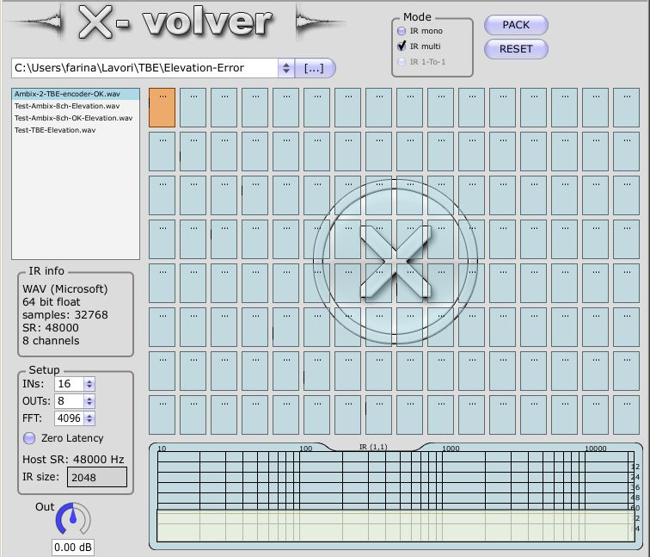
Realtime matrix convolution with X-volver
INTRODUCTION BACKGROUND PAST vs PRESENT VIRTUAL REALITY THE FUTURE: INSIDE VEHICLE
Our filtering engine is X-volver
X-volver is a VST plugin
Real time
Low CPU usage
Very high potential: capable of convolving the A-format (32 channels, 48 kHz, 32bit) with a 32x16 FIR filtering matrix (4096 samples each)
to B-format (16 channels, 48 kHz, 32bit)

Slide 36
Ambisonics for VR
INTRODUCTION BACKGROUND PAST vs PRESENT VIRTUAL REALITY THE FUTURE: INSIDE VEHICLE
Virtual Reality
Augmented Reality
Mixed Reality
Videogames
Enhanced listening experience
Why AMBISONICS ???
Remote fruition of live events:
Concerts, sports…
360° panoramic tours
360° audio/video recordings reproduction
Low computational cost Head-tracking

Slide 37
Ambisonics for VR
INTRODUCTION BACKGROUND PAST vs PRESENT VIRTUAL REALITY THE FUTURE: INSIDE VEHICLE
Virtual Reality
Augmented Reality
Mixed Reality
Videogames
Enhanced listening experience
Why AMBISONICS ???
Remote fruition of live events:
Concerts, sports…
360° panoramic tours
360° audio/video recordings reproduction
Low computational cost Head-tracking

Slide 38
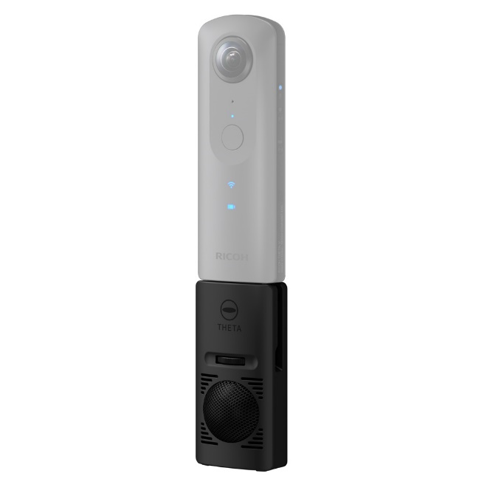
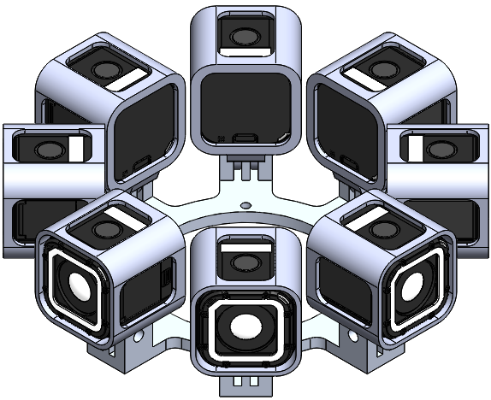
Panoramic video recording systems
INTRODUCTION BACKGROUND PAST vs PRESENT VIRTUAL REALITY THE FUTURE: INSIDE VEHICLE
Ricoh Theta V:
8 GoPro ring:
Easy-to-use
Cheap and compact
Automatic stitching
Includes the TA-1
FOA microphone array
Optional underwater case
Higher quality output
3D (stereoscopic) possible
Slow, offline stitching
No spatial audio recording
Incomplete vertical coverage

Slide 39
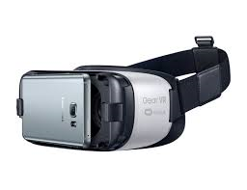
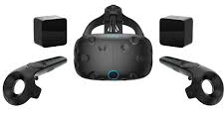
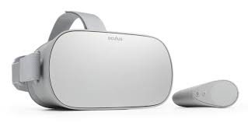
VR reproduction systems
INTRODUCTION BACKGROUND PAST vs PRESENT VIRTUAL REALITY THE FUTURE: INSIDE VEHICLE
360 video with Ambisonics soundtrack
High-level, top quality desktop solutions
Cheap, easy-to-use portable solutions
HTC VIVE
SAMSUNG GEAR VR
SAMSUNG ODISSEY
OCULUS GO

Slide 40
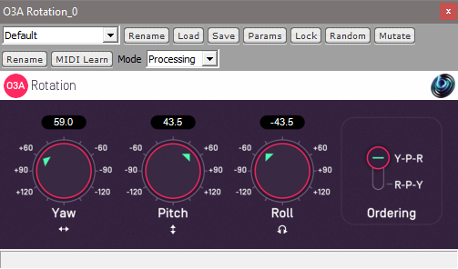
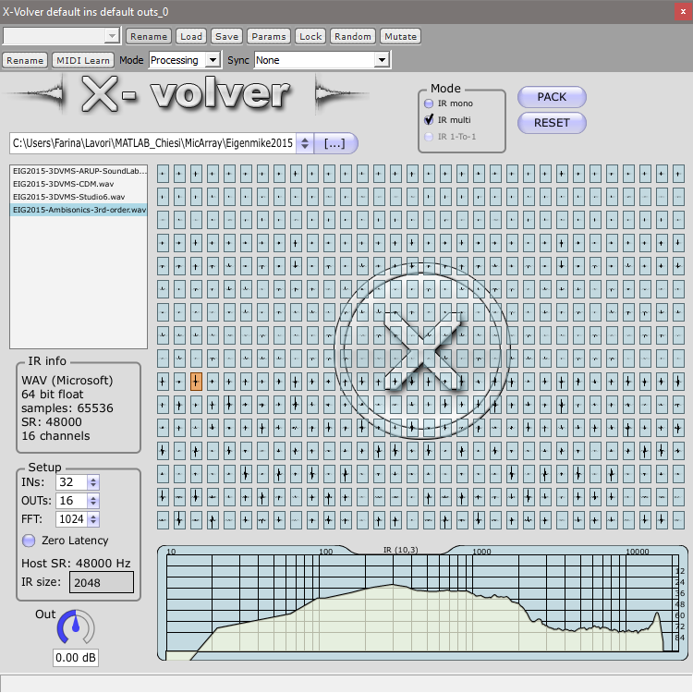
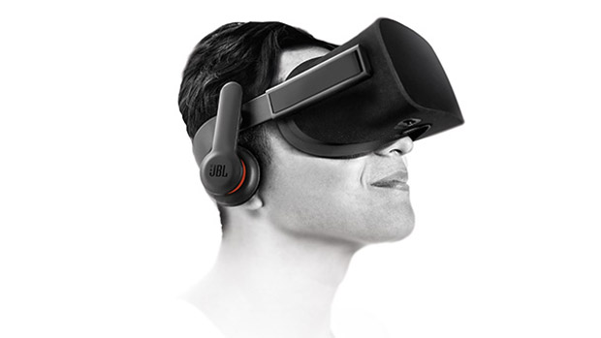
From recording to HMD with head-tracking
INTRODUCTION BACKGROUND PAST vs PRESENT VIRTUAL REALITY THE FUTURE: INSIDE VEHICLE
Eigenmike™ 32
Ambisonics decoder (4x8 or 16x8 channels)
Neumann KU100
8x2 HRTF filter matrix for binaural rendering
3-axis (counter) rotation
Head tracking
X-volver FIR matrix
Ambisonics domain (1st or 3rd order )
HMD with standard headphones

Slide 41

Improvements with Exofield
INTRODUCTION BACKGROUND PAST vs PRESENT VIRTUAL REALITY THE FUTURE: INSIDE VEHICLE
16-speakers system.
The standard cubic geometry has been enhanced adding an horizontal ring of 8 speakers
Individualised HRTFs
personalised HRTFs instead of dummy head (Neumann KU100) HRTFs
Headphones equalization
The headphones of the HMD are individually equalized over the head of each listener

Slide 42
Improvements: the HRTF matrix can be asymmetrical
INTRODUCTION BACKGROUND PAST vs PRESENT VIRTUAL REALITY THE FUTURE: INSIDE VEHICLE
B-format
Left/Right
Symmetrical harmonics
Ambix-to-mid
Convolution matrix
Left ear
+
MID-SIDE (Google)
symmetrical
B-format
Left/Right
NOT Symmetrical harmonics
Ambix-to-side
Convolution matrix
Right ear
-
Ambix-to-left
Convolution matrix
Left ear
B-format
TRUE STEREO (Exofield)
can be asymmetrical
Ambix-to-right
Convolution matrix
Right ear
B-format

Slide 43


Improvements: headphones equalization
INTRODUCTION BACKGROUND PAST vs PRESENT VIRTUAL REALITY THE FUTURE: INSIDE VEHICLE
If Neumann KU100 HRTFs are employed,
correction filters could be measured
with individualized HRTFs, the response of the HMD’s headphones must be measured on the subject wearing Exofield microphones
But no one is doing this, actually!
People listen to VR videos without taking care of equalizing the headphones being employed!

Slide 44
Software for HTC Vive & Samsung Odyssey
INTRODUCTION BACKGROUND PAST vs PRESENT VIRTUAL REALITY THE FUTURE: INSIDE VEHICLE
Player based on Vive Cinema, an open source video player by HTC corporation
Equirectangular 360° video + 3rd order Ambisonics
Mono convolution (mid-side stereo) with Neumann KU100 standard HRTFs
Modified…
True-stereo convolution: Left and Right signals come from convolution with a full filter matrix, obtained convolving the Ambisonics decoding matrix and the HRTFs measured with Exofield microphones
HRTFs loading: measured HRTFs are read from .wav files (1st, 2nd, 3rd order, mono or stereo)
Fast switching: HRTFs sets can be switched on-the-fly during reproduction

Slide 45
Software for HTC Vive & Samsung Odyssey
INTRODUCTION BACKGROUND PAST vs PRESENT VIRTUAL REALITY THE FUTURE: INSIDE VEHICLE
PRO:
Highest quality of video reproduction (high resolution, refresh rate 90 Hz)
Very fast head-tracking sensors
3rd order Ambisonics already implemented
Possibility to change HRTFs set on the fly
Double convolution: true stereo HRTFs supported
CONS:
The HMD is expensive, not portable, cabling still required
High performances, very expensive computer needed
Low quality integrated headphones cannot be easily replaced with better ones

Slide 46
Software for Oculus GO – Samsung Gear VR
INTRODUCTION BACKGROUND PAST vs PRESENT VIRTUAL REALITY THE FUTURE: INSIDE VEHICLE
An Android app developed from scratch with UNITY and compiled with Oculus SDK
Equirectangular 360° video + 1st order Ambisonics
Resonance Audio engine for Ambisonics decoding (open source by Google)
Modified…
Standard plugin: binaural rendering is based on HRTFs measured with Neumann KU100
Our modified plugin: personalized HRTFs measured with EXOFIELD MICROPHONES are employed

Slide 47
Software for Oculus GO – Samsung Gear VR
INTRODUCTION BACKGROUND PAST vs PRESENT VIRTUAL REALITY THE FUTURE: INSIDE VEHICLE
PRO:
Portable solution of very good quality (refresh rate 60Hz)
Very affordable
Decoder ready for 3rd order Ambisonics (Resonance Audio engine)
CONS:
A specific app need to be recompiled for each set of HRTFs
File system not ready for 3rd order Ambisonics (Unity, max 8-channels)
Symmetric HRTF assumed (mid-side convolution)

Slide 48

Exofield Technology for automotive
INTRODUCTION BACKGROUND PAST vs PRESENT VIRTUAL REALITY THE FUTURE: INSIDE VEHICLE
BOSE headrest already on the market, but…
…WE CAN DO IT BETTER !

Slide 49
Exofield Technology for automotive
INTRODUCTION BACKGROUND PAST vs PRESENT VIRTUAL REALITY THE FUTURE: INSIDE VEHICLE
The concept: use Exofield microphones to bring inside vehicle a new advanced 3D audio system for cars
…WE CAN DO IT BETTER !

Slide 50

Exofield Technology for automotive
INTRODUCTION BACKGROUND PAST vs PRESENT VIRTUAL REALITY THE FUTURE: INSIDE VEHICLE
1. Target measurement in a listening room: a top quality 4.1 system
Two rear surround loudspeakers
Exofield microphones
One subwoofer
Two front stereo loudspeakers

Slide 51
Exofield Technology for automotive
INTRODUCTION BACKGROUND PAST vs PRESENT VIRTUAL REALITY THE FUTURE: INSIDE VEHICLE
2. Exofield measurement inside vehicle: the new ASK headrest + stereo dipole
ASK headrest 2.1
Exofield microphones
Stereo dipole

Slide 52

Exofield Technology for automotive
INTRODUCTION BACKGROUND PAST vs PRESENT VIRTUAL REALITY THE FUTURE: INSIDE VEHICLE
ASK headrest: integrated subwoofer and two small surround loudspeakers
Small distance from ears
Presence of head in between
No need to use cross-talk cancelling
Two side loudspeakers for surround
Integrated subwoofer for low frequencies (ASK patent pending)

Slide 53


Exofield Technology for cars
INTRODUCTION BACKGROUND PAST vs PRESENT VIRTUAL REALITY THE FUTURE: INSIDE VEHICLE
Frontal Stereo Dipole
Already patented by ASK (Arletti, Nili, Farina, Ugolotti)
Front positioned (sun visor)
Employed to recreate the front stereo system
Makes use of cross-talk cancellation previosly described

Slide 54
Conclusions
INTRODUCTION BACKGROUND PAST vs PRESENT VIRTUAL REALITY THE FUTURE: INSIDE VEHICLE
Exofield microphones can be employed together with signal processing techniques
developed at UNIPR (ESS, Kirkeby)
Exofield has been developed for standard stereo reproduction but Ambisonics technology is the current standard for spatial audio and VR/AR application (3D audio with head-tracking)
Thanks to Exofield, problems related to generic HRTFs have been solved, allowing for excellent
playback of Ambisonics soundtracks over HMDs
Some experiments already demonstrated that also our past experience with Stereo Dipole can take great benefit from Exofield usage
Exofield could be the key for bringing to market a new 3D Audio system for vehicles: the already patented «Stereo Dipole inside cars» in combination with the new ASK headrest, individually tuned to each person by means of Exofield measurements

Slide 55
END OF PRESENTATION
THANKS FOR ATTENTION

